Slide 1
LinkedList
Lab 3 & Lab 4

Slide 2
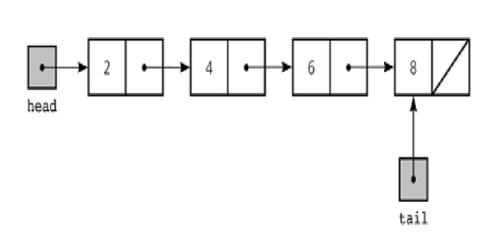
LinkedList

Slide 3
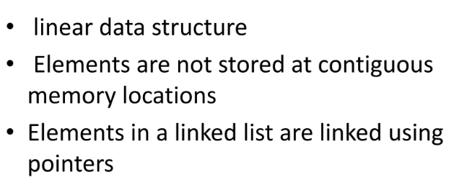
Characteristics of LinkedList

Slide 4

Nodes
data
Address of next Node

Slide 5
Linkedlist Node Creation
struct Node {
int data;
Node* next;
};
data
Address of next Node

Slide 6
Basic Operations of a linkedList
Insertion
Deletion
Display
Search

Slide 7
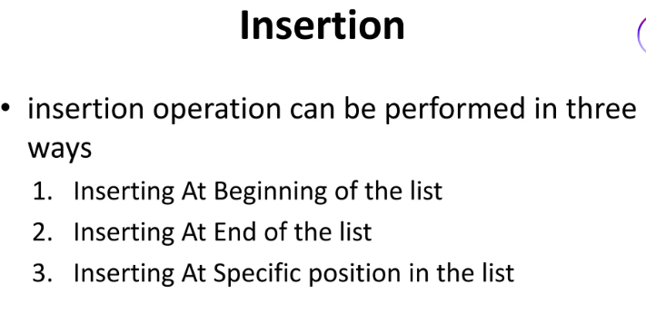
Insertion

Slide 8
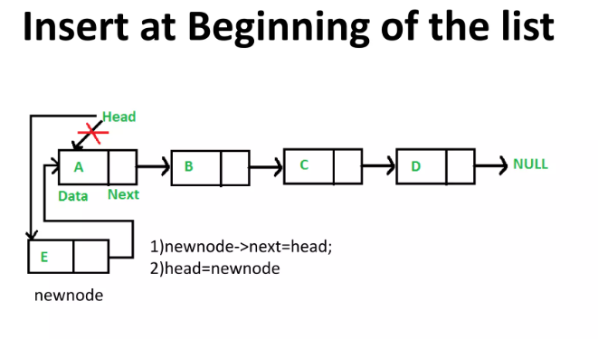

Slide 9
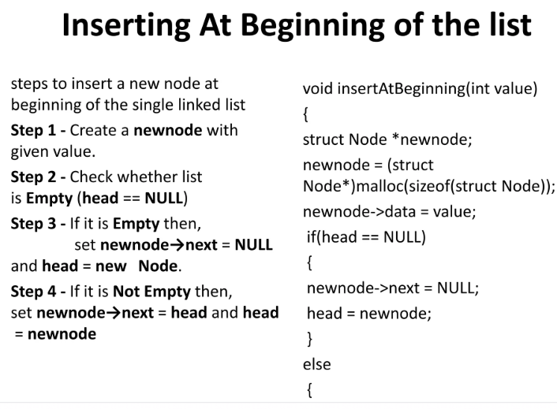
Implementation

Slide 10
Types of LinkedList
Singly LinkedList
Doubly LinkedList
Circular LinkedList

Slide 11
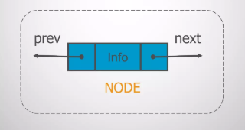
Doubly LinkedList
In Doubly LinkedList, it contains the address of prev and next Nodes.

Slide 12

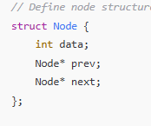
Doubly LinkedList

Slide 13
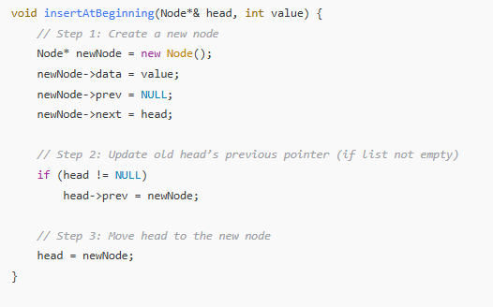
Inserting element at the beginning of Doubly LinkedList

Slide 14
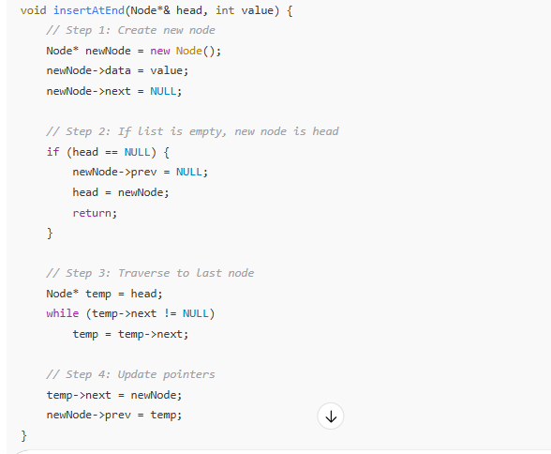
Adding an element at any end in doubly Linkedlist

Slide 15
Time Complexities
O(n)-→ Worst Case
Ω(n) → Best Case
Θ(n)-> Average case

Slide 16
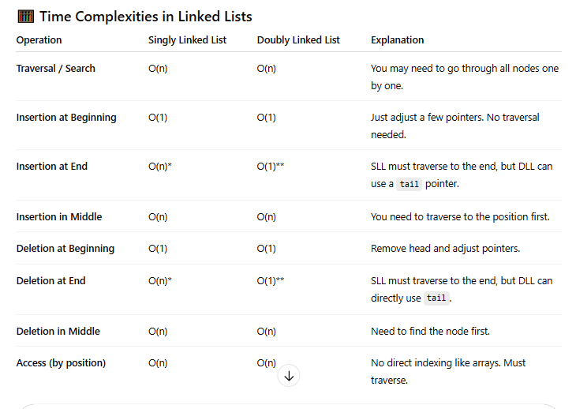
Time Complexities

Slide 17
Stack
Data Structures and algorithms Lab 6

Slide 18

Stack - LIFO
Stacks works in such a way that it has LIFO
Last in first out.
The Stack pointer will always point at the top of Stack
Push Operation - > To add item to top of stack.
Pop Operation - > To Remove item from top of stack.

Slide 19
Stack implementation
Stack Implementation
Using Array list
Using Linked list

Slide 20
Operations of Stack
PUSH
Step 1: First Check whether or not the stack is full.
Step 2: If Stack is full, then exit.
Step 3: If stack is not full, increment the top pointer by one.
Step 4: insert the element where the top pointer is pointing.

Slide 21
Operations of Stack
POP
Step 1 : First, Check whether or not the stack is empty → Is empty
Step 2: it stack is empty, then exit.
Step 3: if stack is not empty, remove the topmost element.
Step 4: Decrement top pointer

Slide 22
Stack using LinkedList lists

Slide 23
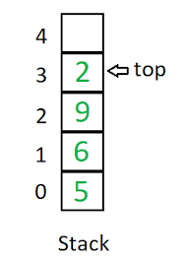
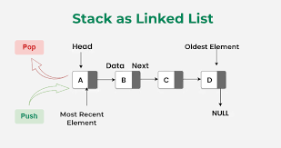
St ack using Linkedlist vs Array

